Slide 1
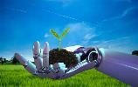
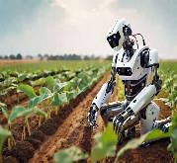
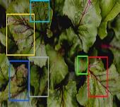
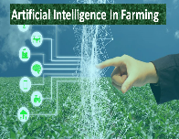
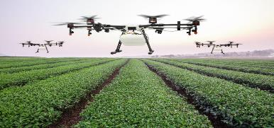
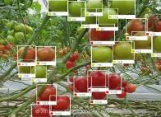
Generative AI Cultivation: Innovations and Insights in Agricultural Disease Management
G.LIKITHA
K.SAiLATHA

Slide 2
CONTEXT
Introduction
How generative AI is used in Agriculture
Challenges in Agriculture & Plant Diseases
AI based solutions
Advancement in plant diseases detection
Case study
Conclusion

Slide 3
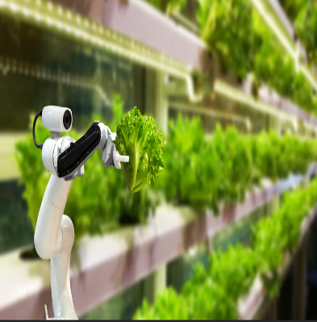
Introduction
Agricultural diseases pose a significant threat to global food security, leading to substantial yield losses and economic instability.
Traditional disease management methods are often reactive, resource-intensive, and sometimes ineffective.
AI technologies, such as machine learning and deep learning, are being applied to solve complex agricultural challenges.
Factors such as climate change, globalization, and evolving pathogens contribute to the complexity of disease management.

Slide 4

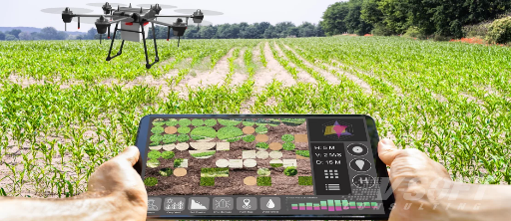
Introduction
Generative AI is being increasingly utilized in agriculture to address various challenges, including disease management.
Data plays a crucial role in disease management, providing insights into disease patterns, environmental factors, and crop health.

Slide 5
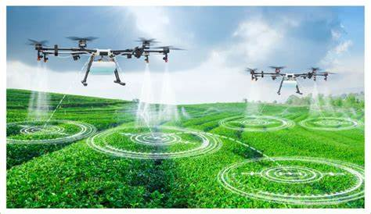
How Generative AI is used in Agriculture
Generative AI models can analyze various data sources such as weather patterns, soil quality, historical yield data, and satellite imagery to predict crop yields. These predictions help farmers make informed decisions regarding planting, harvesting, and resource allocation.
Drones equipped with cameras, satellites, and ground-based sensors capture high-resolution images of crops.
Generative AI models simulate the potential impacts of climate change on agricultural systems, predicting changes in temperature, precipitation patterns, and extreme weather events.

Slide 6
Challenges in Agriculture & Plant Diseases
Climate change: Climate change leads to unpredictable weather patterns, including droughts, floods, and heatwaves.
Increased food Demand: The demand for a particular crop or food is the critical factor that decides the price and production of that crop in the market. Due to increasing population, industrialization, modernization, urbanization, and deforestation, there appears to be a lack of food production in the local market, which in turn causes an increase in the demand for crops/food. Small farmers with a small area of agricultural land often cannot satisfy the sudden increase in food demand. This causes a hike in the crop price, resulting in fewer sales and financial loss in production.
Water scarcity: Water scarcity is a growing concern in agriculture, especially in regions facing droughts and water stress.

Slide 7
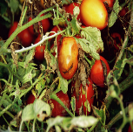
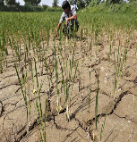
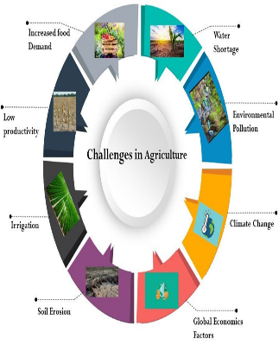
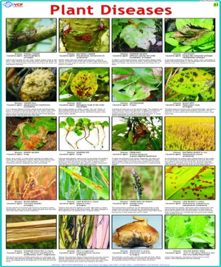
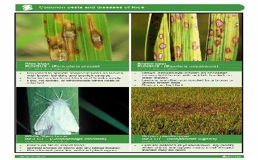
Challenges in Agriculture & Plant Diseases

Slide 8
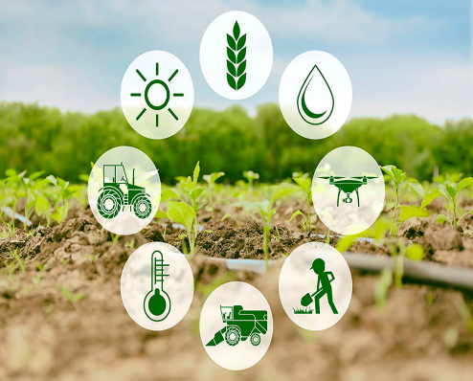
AI Based Solutions
AI-based solutions in agriculture encompass a wide range of applications that leverage artificial intelligence to improve efficiency, yield, and sustainability in farming practices. Some key AI applications in agriculture include:
Precision Agriculture: AI is used to analyze data from sensors, drones, and satellite imagery to optimize farming practices such as planting, irrigation, and fertilization. This helps farmers reduce costs and improve crop yields.
Crop Monitoring: AI algorithms analyze images of crops to detect diseases, pests, and nutrient deficiencies early. This allows farmers to take timely action to protect their crops.

Slide 9
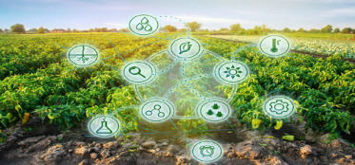
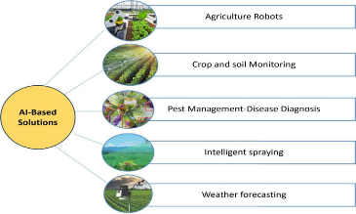
AI Based Solutions
Livestock Monitoring: AI is used to monitor the health and behavior of livestock, helping farmers detect diseases early and improve animal welfare.
Market Forecasting: AI models analyze market data to forecast prices for agricultural commodities, helping farmers make informed decisions about when to sell their crops.
Soil Health Monitoring: AI helps farmers monitor soil health by analyzing soil samples and providing recommendations for improving fertility and reducing erosion.
Robotics and Automation: AI-powered robots and drones are used for tasks such as planting, weeding, and harvesting crops. This reduces the need for manual labor and improves efficiency.

Slide 10
Key Differences between Traditional and AI-Based Plant Disease Detection
Aspect | Traditional Methods | AI-Based Methods
Detection Process | Relies on human observation and expertise to identify visual symptoms. | Utilizes machine learning and computer vision algorithms to analyze images of plants.
Accuracy | Accuracy can vary based on the expertise of the observer. | Can achieve high levels of accuracy, especially in detecting subtle or early-stage symptoms.
Adaptability | Limited adaptability to new diseases or changes in disease symptoms. | Can be trained to detect new diseases or variations in symptoms by updating the AI model with new data.
Decision Support | Provides limited decision support, mostly relying on human judgment. | Offers advanced decision support, providing actionable insights based on data analysis.

Slide 11
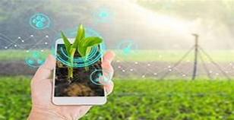
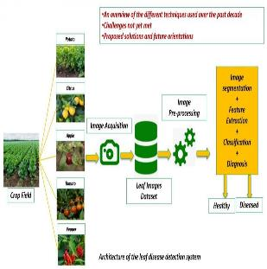
Advancement in plant Diseases detection
Advancements in plant disease detection have been driven by technological innovations, especially in the field of artificial intelligence and digital imaging. Some key advancements include:
AI and Machine Learning: AI algorithms, particularly machine learning models like convolutional neural networks (CNNs), have significantly improved the accuracy and speed of disease detection in plants. These models can analyze large datasets of images to identify patterns associated with diseases, enabling early detection
Internet of Things (IoT): IoT devices, such as sensors and smart farming equipment, can collect real-time data on environmental conditions and plant health. This data can be analyzed using AI algorithms to detect diseases and optimize farming practices.
Mobile Applications: Mobile apps have been developed to allow farmers to easily capture and upload images of diseased plants for analysis. These apps often use AI algorithms to provide instant diagnosis and recommendations for treatment.

Slide 12
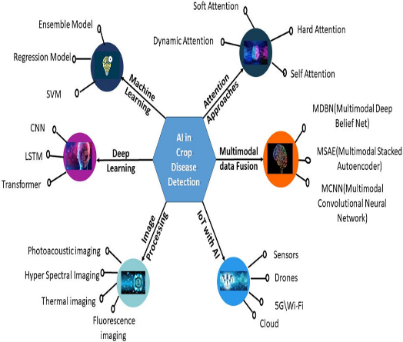
Machine Learning in Classifying Plant Diseases
Machine learning algorithms have been increasingly employed for classifying plant diseases based on symptoms and patterns in images.
1. Convolutional Neural Networks (CNNs): CNNs have been highly successful in classifying plant diseases from images, leveraging their ability to automatically learn and extract features.
2.Image Preprocessing: Preprocessing techniques, such as image normalization, resizing, and color space conversion, are applied to enhance the quality of images for classification.
3. Support Vector Machines (SVMs): SVMs are used for classification tasks in plant disease detection, particularly when dealing with small datasets or when interpretability is important.
Deep Learning in Identifying Plant Diseases
Deep learning has revolutionized the field of plant disease identification by enabling the development of highly accurate and efficient models for detecting diseases in crops.
Deep learning models, particularly Convolutional Neural Networks (CNNs), have shown remarkable success in automatically learning and extracting features from plant images for disease identification.

Slide 13
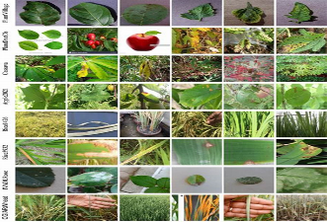
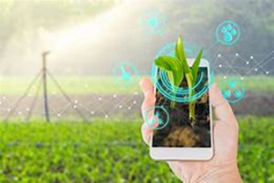
case study
PlantVillage: AI-Powered Crop Disease Management Platform
PlantVillage is an AI-powered platform designed to assist farmers in managing crop diseases effectively. The platform employs AI and crowdsourcing to identify and manage various crop diseases. With a vast database of images showcasing diseased crops, PlantVillage uses machine learning models to recognize diseases accurately.
Farmers can upload images of their crops, and the platform provides detailed information about the disease affecting their crops, along with recommended treatments. This approach enables early disease detection and helps farmers take timely actions to mitigate crop losses, ultimately enhancing agricultural productivity and sustainability.
Leaf Doctor: An AI-Powered Plant Disease Diagnosis Tool

Slide 14
Conclusion
In Conclusion, this paper presentation discusses the farmers’ challenges and their AI-based solutions. AI has many applications in the agriculture sector, which this article reviews. Plant diseases and pests negatively impact the agriculture sector worldwide .It highlights the challenges that must be discussed to provide real-time solutions for early disease detection. Plant diseases pose a significant threat to the global agricultural sector. Although AI-based solutions have seen rapid growth, several challenges must be addressed before developing high- performance, real-time Plant Disease Detection solutions
Generative AI is revolutionizing agricultural disease management by enhancing disease detection accuracy and reducing costs. Its ability to generate synthetic images for training models enables early intervention and improves crop health. As Generative AI continues to evolve, it holds promise for more sustainable and productive farming practices.

Slide 15
THANK YOU

